Slide 1
Subquery in SQL

Slide 2
Sub-query
A sub-query is a SELECT statement that is embedded in a clause of another SELECT statement.
The inner query or the sub-query returns value that is used by the outer query or the main query.
Using a sub-query is equivalent to performing two sequential queries and using the result of the inner query as the search value for the outer query.
They can very useful when we need to select rows from a table with a condition that depends on the data in the table itself.
Notes:
Lesson Aim
In this lesson, you learn about more advanced features of the SELECT statement. You can write subqueries in the WHERE clause of another SQL statement to obtain values based on an unknown conditional value. This lesson covers single-row subqueries and multiple-row subqueries.

Slide 3
Subquery Syntax
SELECT select_list
FROM table
WHERE expr operator
(SELECT select_list
FROM table);
The subquery (inner query) executes once before the main query.
The result of the subquery is used by the main query (outer query).
Notes:
Subqueries
A subquery is a SELECT statement that is embedded in a clause of another SELECT statement. You can build powerful statements out of simple ones by using subqueries. They can be very useful when you need to select rows from a table with a condition that depends on the data in the table itself.
You can place the subquery in a number of SQL clauses, including:
The WHERE clause
The HAVING clause
The FROM clause
In the syntax:
operator includes a comparison condition such as >, =, or IN
Note: Comparison conditions fall into two classes: single-row operators (>, =, >=, <, <>, <=) and multiple-row operators (IN, ANY, ALL).
The subquery is often referred to as a nested SELECT, sub-SELECT, or inner SELECT statement. The subquery generally executes first, and its output is used to complete the query condition for the main or outer query.
Instructor Note
Additionally, subqueries can be placed in the CREATE VIEW statement, CREATE TABLE statement, UPDATE statement, INTO clause of an INSERT statement, and SET clause of an UPDATE statement.

Slide 4
Using a Subquery to Solve a Problem
Who has a salary greater than Abel’s?
Main Query:
Which employees have salaries greater than Amar’s salary?
?
Subquery
?
What is Amar’s salary?
Notes:
Using a Subquery to Solve a Problem
Suppose you want to write a query to find out who earns a salary greater than Abel’s salary.
To solve this problem, you need two queries: one to find what Abel earns, and a second query to find who earns more than that amount.
You can solve this problem by combining the two queries, placing one query inside the other query.
The inner query or the subquery returns a value that is used by the outer query or the main query. Using a subquery is equivalent to performing two sequential queries and using the result of the first query as the search value in the second query.
Instructor Note
This lesson concentrates on noncorrelated subqueries.

Slide 5
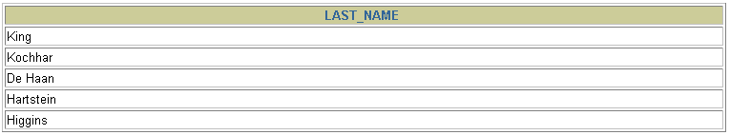
Using a Subquery
SELECT e_name
FROM employees
WHERE salary >
(SELECT salary
FROM employees
WHERE e_name = ‘Amar');
11000
Notes:
Using a Subquery
In the slide, the inner query determines the salary of employee Abel. The outer query takes the result of the inner query and uses this result to display all the employees who earn more than this amount.
Instructor Note
Execute the subquery (inner query) on its own first to show the value that the subquery returns. Then execute the outer query using the result returned by the inner query. Finally, execute the entire query (containing the subquery), and show that the result is the same.

Slide 6
Guidelines for Using Subqueries
Enclose subqueries in parentheses.
Place subqueries on the right side of the comparison condition.
The ORDER BY clause in the subquery is not needed unless you are performing Top-N analysis.
Use single-row operators with single-row subqueries and use multiple-row operators with multiple-row subqueries.
Notes:
Guidelines for Using Subqueries
A subquery must be enclosed in parentheses.
Place the subquery on the right side of the comparison condition for readability.
Prior to release Oracle8i, subqueries could not contain an ORDER BY clause. Only one ORDER BY clause can be used for a SELECT statement, and if specified it must be the last clause in the main SELECT statement. Starting with release Oracle8i, an ORDER BY clause can be used and is required in the subquery to perform Top-N analysis.
Two classes of comparison conditions are used in subqueries: single-row operators and multiple-row operators.
Instructor Note
A subquery can execute multiple times in correlated subqueries. Students may ask how many subqueries can be written. The Oracle server imposes no limit on the number of subqueries; the limit is related to the buffer size that the query uses.

Slide 7
Types of Subqueries
Single-row subquery
Main query
returns
Subquery
ST_CLERK
Multiple-row subquery
Main query
returns
ST_CLERK
SA_MAN
Subquery
Notes:
Types of Subqueries
Single-row subqueries: Queries that return only one row from the inner SELECT statement
Multiple-row subqueries: Queries that return more than one row from the inner SELECT statement
Note: There are also multiple-column subqueries: Queries that return more than one column from the inner SELECT statement.
Instructor Note
Multiple column subqueries are also available.

Slide 8
Single-Row Subqueries
Return only one row
Use single-row comparison operators
Operator
=
>
>=
<
<=
<>
Meaning
Equal to
Greater than
Greater than or equal to
Less than
Less than or equal to
Not equal to
Notes:
Single-Row Subqueries
A single-row subquery is one that returns one row from the inner SELECT statement. This type of subquery uses a single-row operator. The slide gives a list of single-row operators.
Example
Display the employees whose job ID is the same as that of employee 141.
SELECT last_name, job_id
FROM employees
WHERE job_id =
(SELECT job_id
FROM employees
WHERE employee_id = 141);

Slide 9

Executing Single-Row Subqueries Display the details of those employees whose job-id is same as the job-id of employee_id 141 and salary more than the salary of employeed_id 143.
SELECT last_name, job_id, salary
FROM employees
WHERE job_id =
(SELECT job_id
FROM employees
WHERE employee_id = 141)
AND salary >
(SELECT salary
FROM employees
WHERE employee_id = 143);
ST_CLERK
2600
Notes:
Executing Single-Row Subqueries
A SELECT statement can be considered as a query block. The example on the slide displays employees whose job ID is the same as that of employee 141 and whose salary is greater than that of employee 143.
The example consists of three query blocks: the outer query and two inner queries. The inner query blocks are executed first, producing the query results ST_CLERK and 2600, respectively. The outer query block is then processed and uses the values returned by the inner queries to complete its search conditions.
Both inner queries return single values (ST_CLERK and 2600, respectively), so this SQL statement is called a single-row subquery.
Note: The outer and inner queries can get data from different tables.

Slide 10
Display the employee details whose salary is equal to the minimum salary
SELECT last_name, job_id, salary
FROM employees
WHERE salary =
(SELECT MIN(salary)
FROM employees);
2500
Notes:
Using Group Functions in a Subquery
You can display data from a main query by using a group function in a subquery to return a single row. The subquery is in parentheses and is placed after the comparison condition.
The example on the slide displays the employee last name, job ID, and salary of all employees whose salary is equal to the minimum salary. The MIN group function returns a single value (2500) to the outer query.

Slide 11
The HAVING Clause with Subqueries
The Oracle server executes subqueries first.
The Oracle server returns results into the HAVING clause of the main query.
Query: To display all the departments that have a minimum salary greater than that of the minimum salary of department 50.
SELECT department_id, MIN(salary)
FROM employees
GROUP BY department_id
HAVING MIN(salary) >
(SELECT MIN(salary)
FROM employees
WHERE department_id = 50);
2500
Notes:
The HAVING Clause with Subqueries
You can use subqueries not only in the WHERE clause, but also in the HAVING clause. The Oracle server executes the subquery, and the results are returned into the HAVING clause of the main query.
The SQL statement on the slide displays all the departments that have a minimum salary greater than that of department 50.
Example
Find the job with the lowest average salary.
SELECT job_id, AVG(salary)
FROM employees
GROUP BY job_id
HAVING AVG(salary) = (SELECT MIN(AVG(salary))
FROM employees
GROUP BY job_id);
…

Slide 12
What is Wrong with this Statement?
SELECT employee_id, last_name
FROM employees
WHERE salary =
(SELECT MIN(salary)
FROM employees
GROUP BY department_id);
ERROR at line 4:
ORA-01427: single-row subquery returns more than one row
Single-row operator with multiple-row subquery
Notes:
Errors with Subqueries
One common error with subqueries is more than one row returned for a single-row subquery.
In the SQL statement on the slide, the subquery contains a GROUP BY clause, which implies that the subquery will return multiple rows, one for each group it finds. In this case, the result of the subquery will be 4400, 6000, 2500, 4200, 7000, 17000, and 8300.
The outer query takes the results of the subquery (4400, 6000, 2500, 4200, 7000, 17000, 8300) and uses these results in its WHERE clause. The WHERE clause contains an equal (=) operator, a single-row comparison operator expecting only one value. The = operator cannot accept more than one value from the subquery and therefore generates the error.
To correct this error, change the = operator to IN.

Slide 13
Will this Statement Return Rows?
SELECT e_name, job_id
FROM employees
WHERE job_id =
(SELECT job_id
FROM employees
WHERE e_name = ‘Raj');
no rows selected
Subquery returns no values
Notes:
Problems with Subqueries
A common problem with subqueries is no rows being returned by the inner query.
In the SQL statement on the slide, the subquery contains a WHERE clause. Presumably, the intention is to find the employee whose name is Haas. The statement is correct but selects no rows when executed.
There is no employee named Haas. So the subquery returns no rows. The outer query takes the results of the subquery (null) and uses these results in its WHERE clause. The outer query finds no employee with a job ID equal to null, and so returns no rows. If a job existed with a value of null, the row is not returned because comparison of two null values yields a null, therefore the WHERE condition is not true.

Slide 14
Multiple-Row Subqueries
Queries that return more than one row from the inner SELECT statement.
Use multiple-row comparison operators.
Operator
IN
ANY
ALL
Meaning
Equal to any member in the list
Compare value to each value returned by the subquery
Compare value to every value returned by the subquery
Notes:
Multiple-Row Subqueries
Subqueries that return more than one row are called multiple-row subqueries. You use a multiple-row operator, instead of a single-row operator, with a multiple-row subquery. The multiple-row operator expects one or more values.
SELECT last_name, salary, department_id
FROM employees
WHERE salary IN (SELECT MIN(salary)
FROM employees
GROUP BY department_id);
Example
Find the employees who earn the same salary as the minimum salary for each department.
The inner query is executed first, producing a query result. The main query block is then processed and uses the values returned by the inner query to complete its search condition. In fact, the main query would appear to the Oracle server as follows:
SELECT last_name, salary, department_id
FROM employees
WHERE salary IN (2500, 4200, 4400, 6000, 7000, 8300, 8600, 17000);

Slide 15
Using the IN Operator in Multiple-Row Subqueries Display the details of those employees whose salary is same as any ‘IT_Prog’ salaries but they are not ‘IT_Prog’
SELECT employee_id, e_name, job_id, salary
FROM employees
WHERE salary IN
(SELECT salary
FROM employees
WHERE job_id = 'IT_PROG')
AND job_id <> 'IT_PROG';
9000, 6000, 4200
Harish clerk 9000
Ramesh salesman 6000
Ravi clerk 4200
Amar clerk 6000
Notes:
Multiple-Row Subqueries (continued)
The ANY operator (and its synonym, the SOME operator) compares a value to each value returned by a subquery. The slide example displays employees who are not IT programmers and whose salary is less than that of any IT programmer. The maximum salary that a programmer earns is $9,000.
<ANY means less than the maximum. >ANY means more than the minimum. =ANY is equivalent to IN.
<ALL means less than the maximum. >ALL means more than the minimum.
Instructor Note
When using SOME or ANY, you often use the DISTINCT keyword to prevent rows from being selected several times.

Slide 16
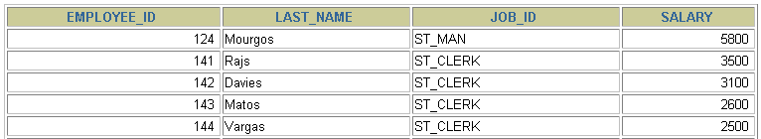
Using the ANY Operator in Multiple-Row Subqueries Display the details of those employees whose salary is less than any ‘IT_Prog’ and who are not ‘IT_Prog’
SELECT employee_id, e_name, job_id, salary
FROM employees
WHERE salary < ANY
(SELECT salary
FROM employees
WHERE job_id = 'IT_PROG')
AND job_id <> 'IT_PROG';
9000, 6000, 4200
Notes:
Multiple-Row Subqueries (continued)
The ANY operator (and its synonym, the SOME operator) compares a value to each value returned by a subquery. The slide example displays employees who are not IT programmers and whose salary is less than that of any IT programmer. The maximum salary that a programmer earns is $9,000.
<ANY means less than the maximum. >ANY means more than the minimum. =ANY is equivalent to IN.
<ALL means less than the maximum. >ALL means more than the minimum.
Instructor Note
When using SOME or ANY, you often use the DISTINCT keyword to prevent rows from being selected several times.

Slide 17
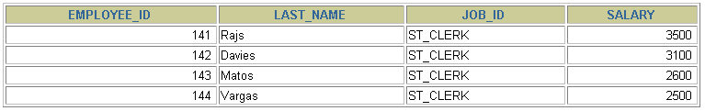
Using the ALL Operator in Multiple-Row Subqueries Display the details of those employees whose salary is less than all ‘IT_Prog’ and who are not ‘IT_Prog’
SELECT employee_id, last_name, job_id, salary
FROM employees
WHERE salary < ALL
(SELECT salary
FROM employees
WHERE job_id = 'IT_PROG')
AND job_id <> 'IT_PROG';
9000, 6000, 4200
Notes:
Multiple-Row Subqueries (continued)
The ALL operator compares a value to every value returned by a subquery. The slide example displays employees whose salary is less than the salary of all employees with a job ID of IT_PROG and whose job is not IT_PROG.
>ALL means more than the maximum, and <ALL means less than the minimum.
The NOT operator can be used with IN, ANY, and ALL operators.

Slide 18
ANY operator, Con’t…
< ANY: means less than the maximum.
> ANY: means more than the minimum.
= ANY: is equivalent to IN.

Slide 19
ALL operator, Con’t…
< ALL: means less than the minimum.
> ALL: means more than the maximum.

Slide 20
Multiple-column subqueries
If we want to compare two or more columns, we must write a compound WHERE clause using logical operators, and we call it a multiple-column subqueries.
Notes:
Practice 6
1. Write a query to display the last name and hire date of any employee in the same department as Zlotkey. Exclude Zlotkey.
2. Create a query to display the employee numbers and last names of all employees who earn more than the average salary. Sort the results in ascending order of salary.
3. Write a query that displays the employee numbers and last names of all employees who work in a department with any employee whose last name contains a u. Place your SQL statement in a text file named lab6_3.sql. Run your query.

Slide 21
Example 1
To display the product_id and quantity of those items in the item table that match both the product_id and quantity of an item whose order_id is 600.
Select product_id, qty from item where (product_id, qty) IN (Select product_id, qty from item where order_id = 600);

Slide 22
Example 2 Display the employee name, department name, and salary of any employee whose salary and commission match the salary and commission of any employee located in Delhi.
SELECT e.ename, d.dname, e.sal
FROM emp e, dept d
WHERE (sal , comm) IN
(SELECT sal, comm
FROM emp
WHERE d.loc = ‘ Delhi');

Slide 23
Co-related Sub Query
A correlated subquery is evaluated once for each row processed by the parent statement.
A correlated subquery is one way of reading every row in a table and comparing values in each row against related data. It is used whenever a subquery must return a different result or set of results for each candidate row considered by the main query.
In other words, you can use a correlated subquery to answer a multipart question whose answer depends on the value in each row processed by the parent statement.

Slide 24
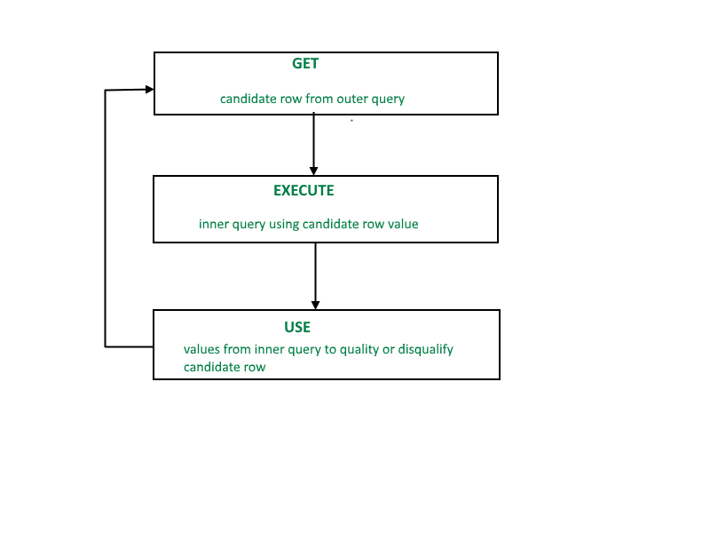
Co-related Sub Query

Slide 25
SELECT column1, column2, ....
FROM table1 outer
WHERE column1 operator
(SELECT column1, column2
FROM table2
WHERE expr1 =
outer.expr2);

Slide 26
Find all the employees who earn more than the average salary in their department.
SELECT last_name, salary, department_id
FROM employees outer
WHERE salary >(SELECT AVG(salary)
FROM employees
WHERE department_id =
outer.department_id group by department_id);

Slide 27
Using the EXISTS Operator
The Exist operator is used to test the existence of any record in the subquery. The Exist operator return true if the subquery returns one or more records.
Example: Find the employees who have at least one person reporting to them.
Select emp_id, name, job_id, dept_id
from emp outer
where exists(select manager_id from emp where manager_id = outer.emp_id;)

Slide 28
Not Exist Operator
Find all departments that do not have any employees.
select dept_id, dept_name
from department d
where not exist
(select dept_id
from employee
where dept_id = d. dept_id;)

Slide 29
Non-correlated Subqueries Vs. Correlated Subqueries
With a normal nested subquery, the inner SELECT query runs first and executes once, returning values to be used by the main query. A correlated subquery, however, executes once for each candidate row considered by the outer query. In other words, the inner query is driven by the outer query.
When a Subquery is executed for each of the rows of the outer query then it is termed as a Correlated Subquery., but for a non-correlated subquery, the inner query is not executed for each of the rows of the outer query.

Slide 30
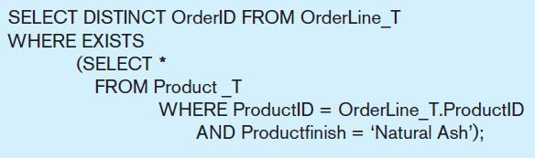
Correlated Subquery Example
Show all orders that include furniture finished in natural ash
The EXISTS operator will return a TRUE value if the subquery resulted in a non-empty set, otherwise it returns a FALSE
➔ A correlated subquery always refers to an attribute from a table referenced in the outer query
The subquery is testing for a value that comes from the outer query

Slide 31
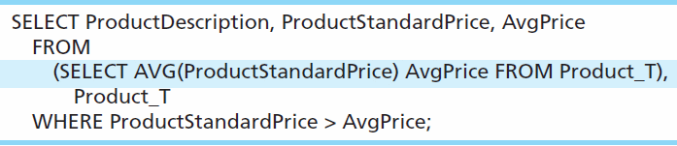
Another Subquery Example
Show all products whose standard price is higher than the average price
One column of the subquery is an aggregate function that has an alias name. That alias can then be referred to in the outer query
Subquery forms the derived table used in the FROM clause of the outer query
The WHERE clause normally cannot include aggregate functions, but because the aggregate is performed in the subquery its result can be used in the outer query’s WHERE clause

Slide 32
CORRELATED UPDATE
Use a correlated subquery to update rows in one table based on rows from another table.
UPDATE table1 alias1
SET column = (SELECT expression
FROM table2 alias2
WHERE alias1.column =
alias2.column);

Slide 33
CORRELATED DELETE
Use a correlated subquery to delete rows in one table based on the rows from another table.
DELETE FROM table1 alias1
WHERE column1 operator
(SELECT expression
FROM table2 alias2
WHERE alias1.column = alias2.column);

Slide 34
Thank You

